Slide 1

Healthcare Disparities in Maternal Mortality
Mamadu Bah
CTEC 426

Slide 2

What is Mortality
Pregnancy mortality refers to deaths that occur during or within one year after pregnancy

Slide 3
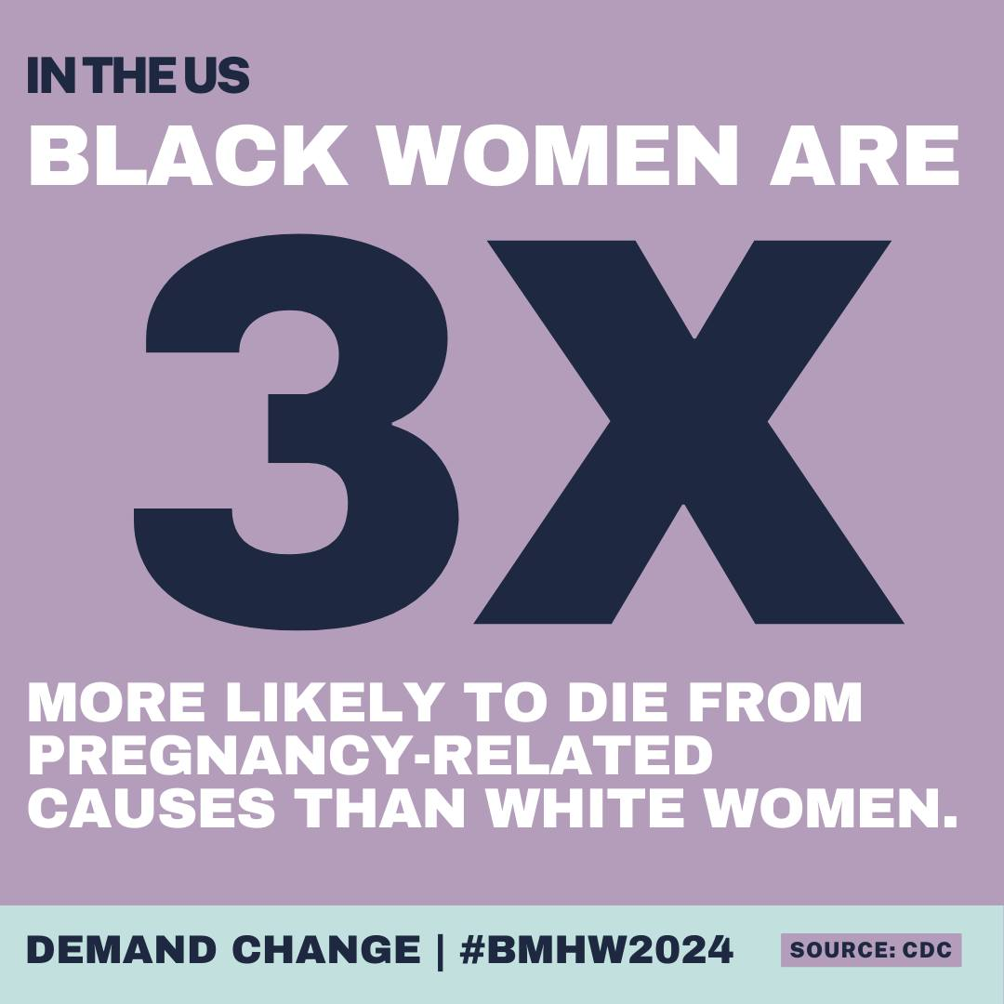
Problem
Research Question: How do maternal mortality rates differ among Black, White, and Asian women from 2010 to 2022?
Why This Topic: Black women are 3–4× more likely to die from pregnancy-related causes.
Causes: Healthcare bias, limited access, and systemic inequality.
Goal: Use data analysis to confirm disparities and visualize long-term trends.
Objective: Highlight the issue and provide data-driven recommendations for change
Notes:
I chose this topic because I wanted to see how big the gap really is and whether things have improved. The data shows that Black women still face the highest maternal mortality rates due to systemic healthcare inequality.

Slide 4

Organization Fit
Organization: Black Mamas Matter Alliance
Mission: Promote Black maternal health, rights, and justice.
How It Connects:
My analysis provides data visuals to support awareness and advocacy.
Results can help shape future policy and resource decisions.
Notes:
My project aligns with the Black Mamas Matter Alliance since their mission is to bring awareness and push for change in Black maternal healthcare.

Slide 5

Data Questions & Prediction
How do maternal mortality rates differ among Black, White, and Asian women?
What are the trends over time (2010–2022)?
How consistent is the racial gap across years?
What does the distribution of rates tell us about inequality?
Prediction Goal: Use multi-year data to forecast which groups remain at highest risk and visualize the persistent gap.

Slide 6
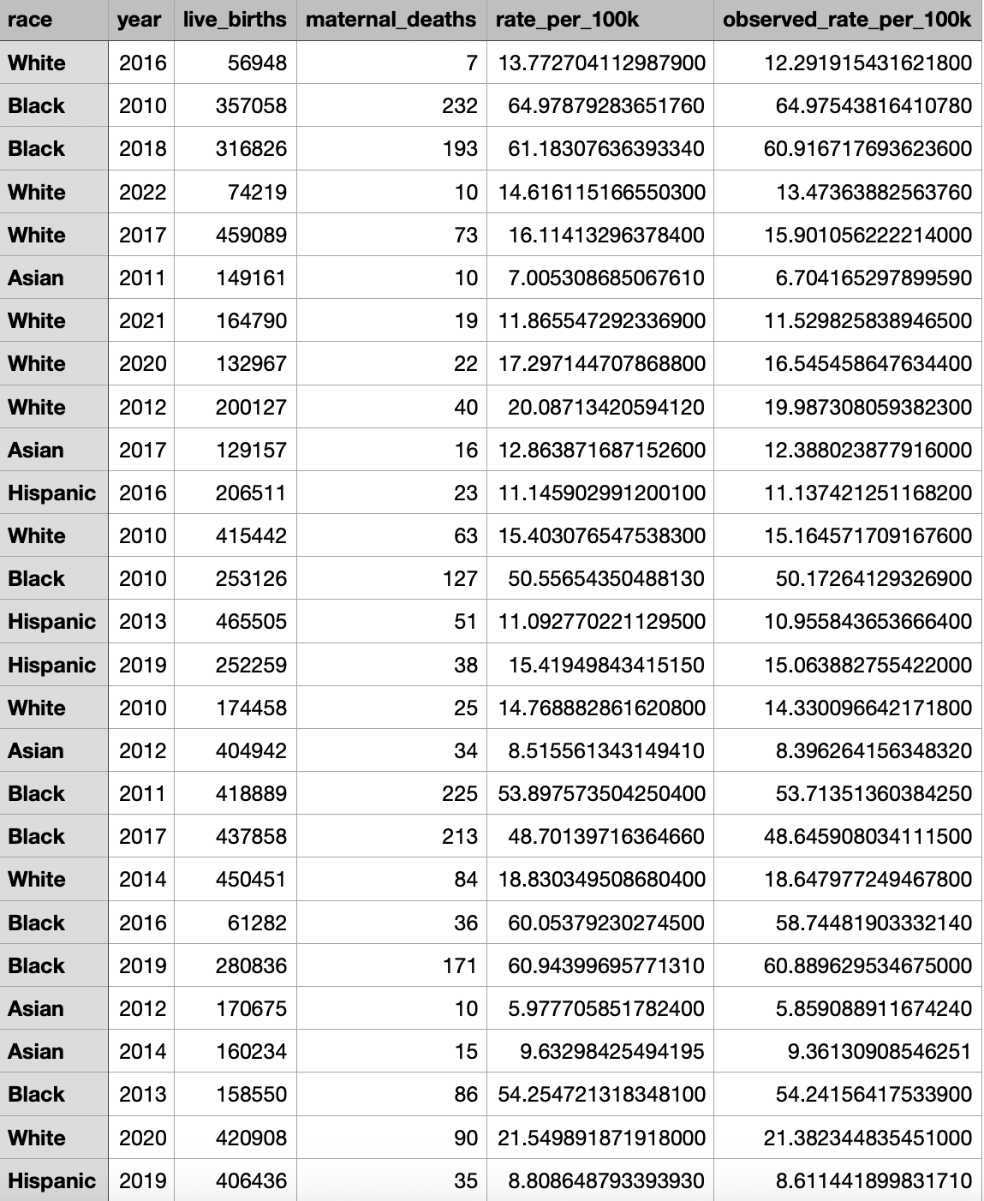
Dataset

Slide 7
Ingestion Overview
Source: Dataset modeled from CDC data (2010–2022).
Size: 10,000 rows × 6 columns.
Variables: race, year, live_births, maternal_deaths, rate_per_100k, observed_rate_per_100k.
Unit of Analysis: One race-year record.
Subset Used: Black, White, and Asian women only.
Notes:
The dataset includes 10,000 rows showing mortality rates by race and year. It’s based on CDC trends but modeled synthetically for analysis..

Slide 8
Wrangling
Removed Hispanic category to focus comparison.
Converted numeric values and dropped missing data.
Added calculated column for observed_rate_per_100k.
Final dataset: 10,000 rows × 5 features.
Notes:
I cleaned the data by removing missing values and calculating consistent mortality rates per 100,000 births.

Slide 9
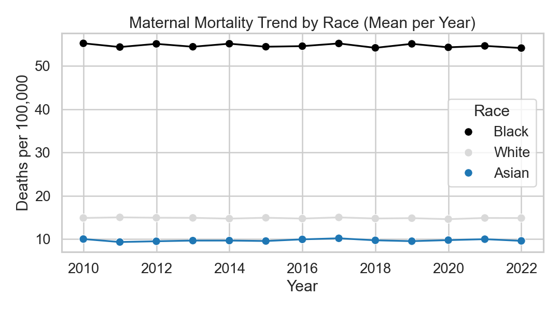
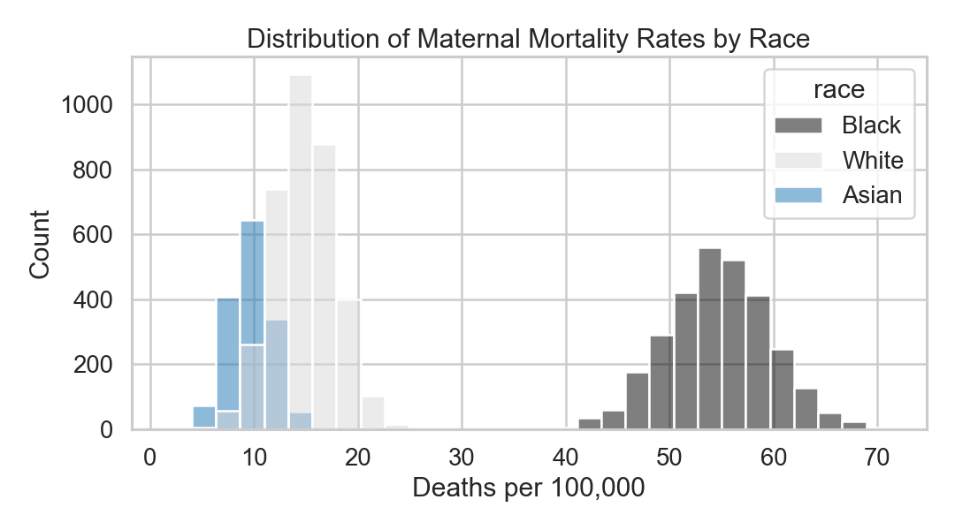
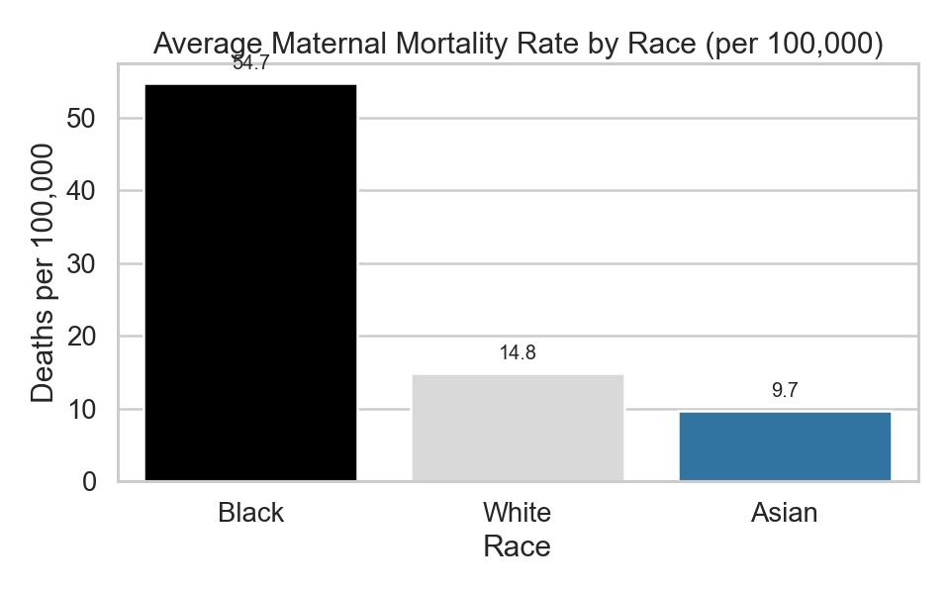
Notes:
My visuals make it clear that Black women consistently have the highest maternal mortality rate across all years.

Slide 10
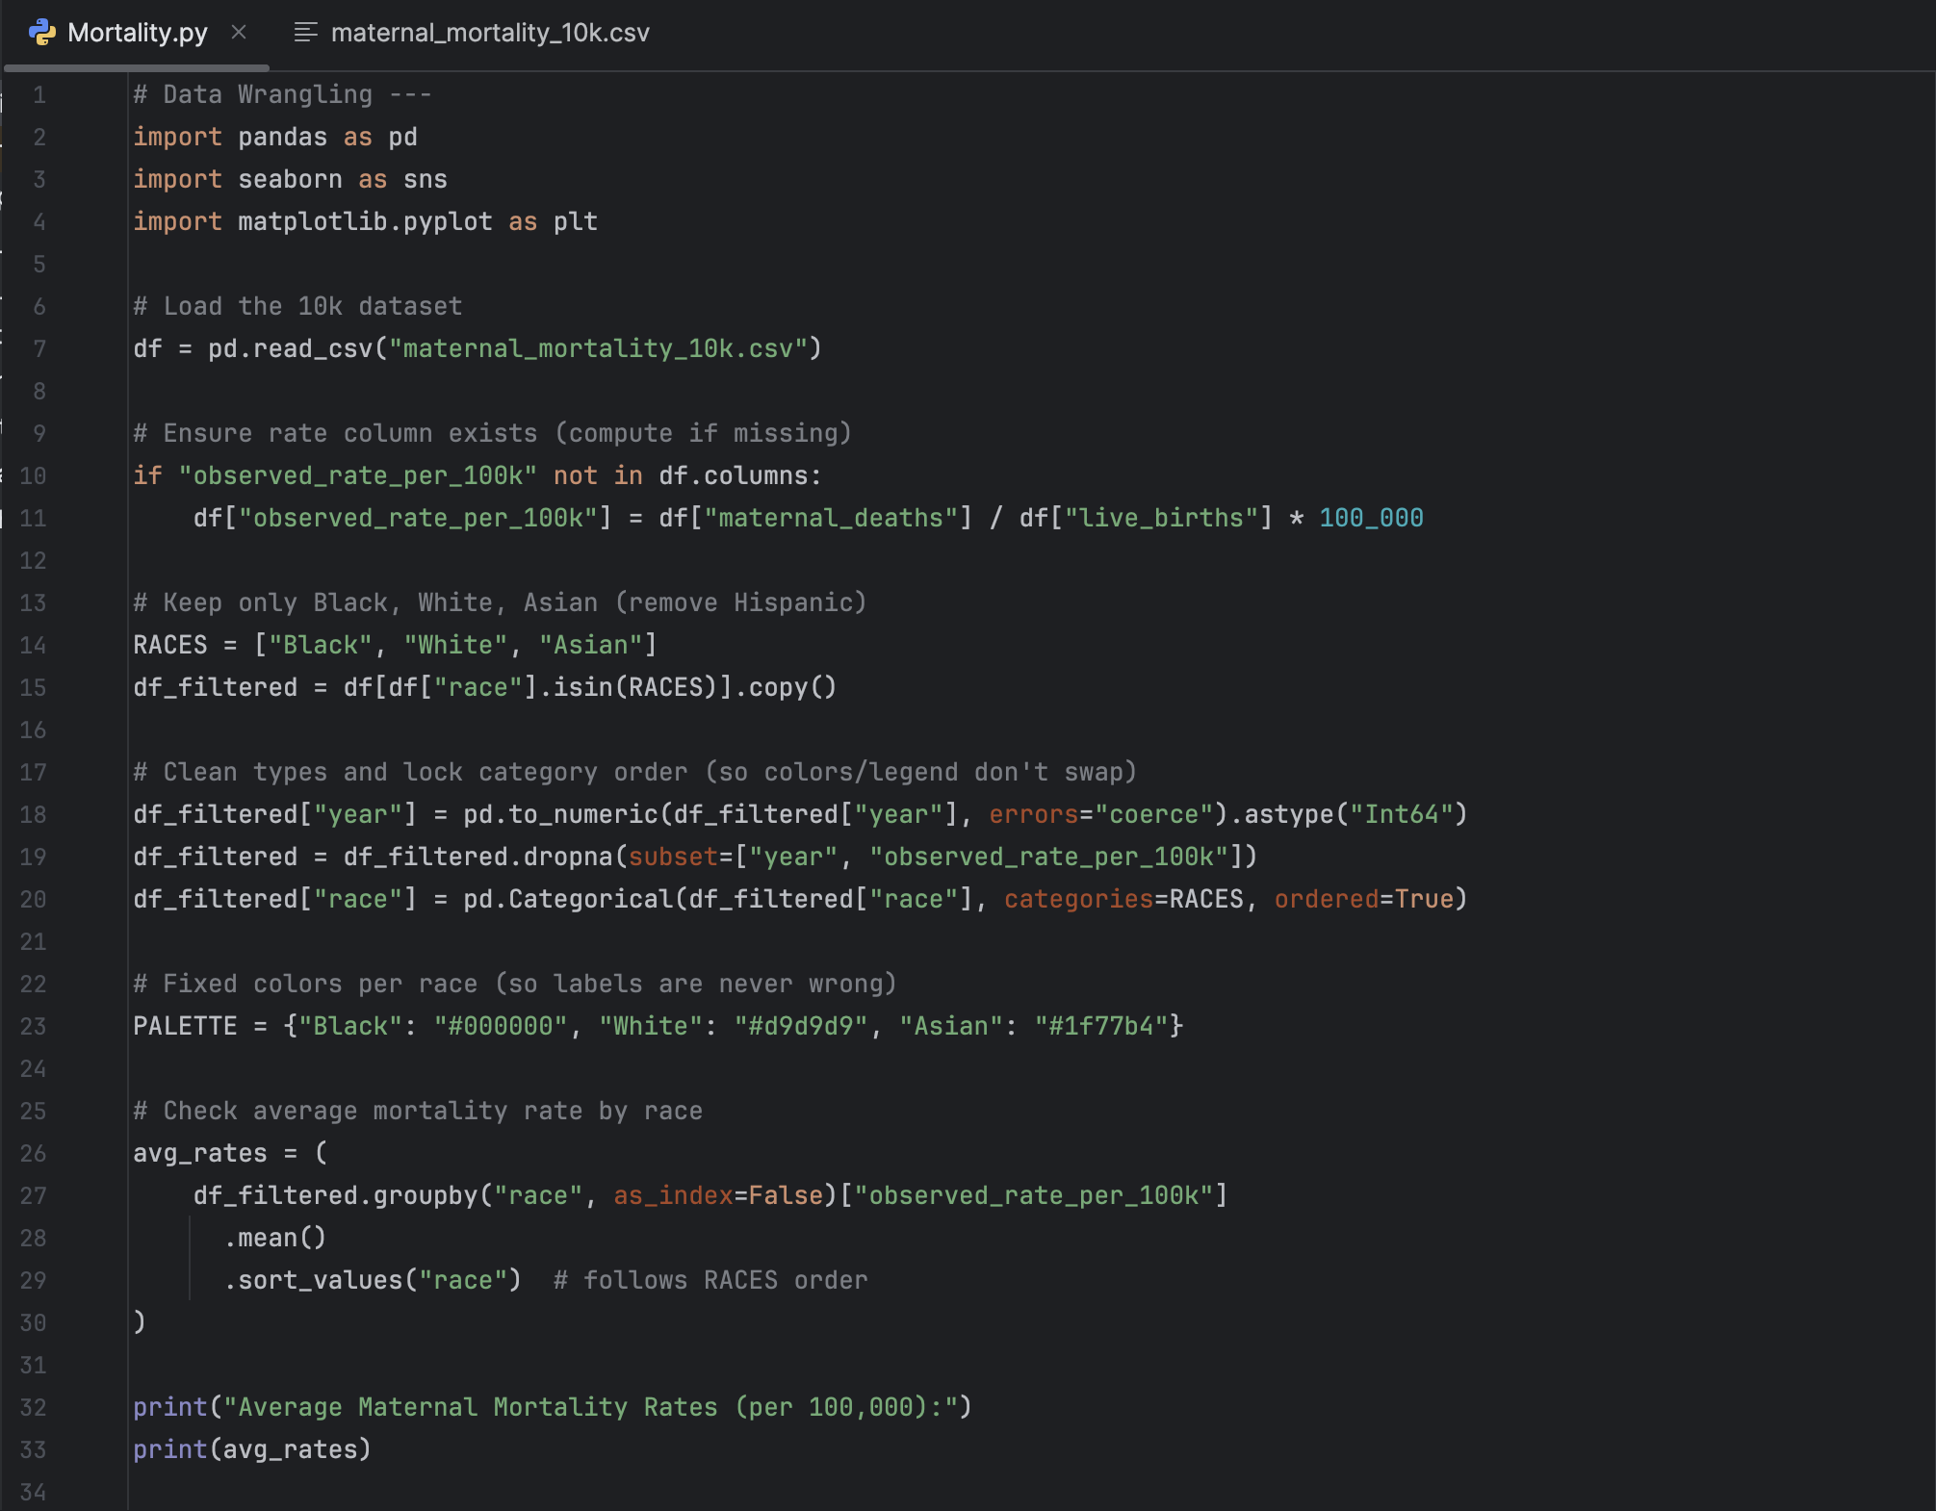
Code
Notes:
This is the code I used to clean my dataset
At first, my data had a few problems — it was randomized, included Hispanic rows I didn’t need, and had some missing or incomplete values.
I used pandas to clean the data, remove errors, and calculate the mortality rate per 100,000 births.

Slide 11
Predictive Analytics (Model)
Technique: Logistic Regression
Goal: Predict high-risk records (≥30 deaths per 100k)
Features: race, year, live_births
Target: High risk (1 = yes, 0 = no)
Results: Model identified Black group as high risk most often
Notes:
I used logistic regression to predict which groups were high risk. It confirmed that Black women consistently fell into the high-risk category. Logistic regression is a simple machine learning model that predicts a yes or no outcome. In my project, it was used to predict if a record was high-risk, and it showed that Black women were most likely to fall into that category.

Slide 12

EDA Findings
Black women’s maternal mortality rate averages 3.7× higher than Asian women and 3.1× higher than White women.
The gap persisted across all years (2010–2022).
Rates peaked in 2021, then slightly decreased, but disparities remained.
The histogram and line charts show clear, consistent inequality.

Slide 13

Data Insights
Average rate: Black ≈ 55, White ≈ 15, Asian ≈ 10
The racial gap hasn’t narrowed from 2010–2022
2021 had the highest rates across all groups
Realistic Action: Expand support programs and improve healthcare bias training
Notes:
The biggest insight is that nothing has changed — Black women’s rates remain over three times higher than other groups.

Slide 14

Proposed Data Product
Blog or Awareness Campaign
Blog or TikTok for awareness and family support donations
Users: Public health agencies, advocates, and communities
Value: Easy access to insights that drive change
Notes:
I want to make the data more interactive and visible — through a blog or social media campaign that spreads awareness and helps families.

Slide 15
Challenges
Finding a usable dataset was difficult — had to switch multiple times
Next time, start with PyCharm for better organization
Spend more time learning and testing the data early

Slide 16
References
Centers for Disease Control and Prevention (CDC). (2023). Maternal mortality rates in the United States, 2018–2022. National Center for Health Statistics. https://www.cdc.gov/nchs
Kaiser Family Foundation (KFF). (2024). Racial disparities in maternal and infant health outcomes. https://www.kff.org
World Health Organization (WHO). (2022). Trends in maternal mortality: 2000–2020 estimates. https://www.who.int
Black Mamas Matter Alliance. (2023). Advancing Black maternal health, rights, and justice. https://blackmamasmatter.org
U.S. National Vital Statistics System (NVSS). (2023). Provisional maternal mortality data. Centers for Disease Control and Prevention.

